Slide 1
PowerShell 5
25-Apr-18
Appendix
Online

Slide 2
PowerShell 5
1
2
3
4
5
6
7
8
Enterprise PowerShell Scripting 05 2017 Bootcamp

Slide 3
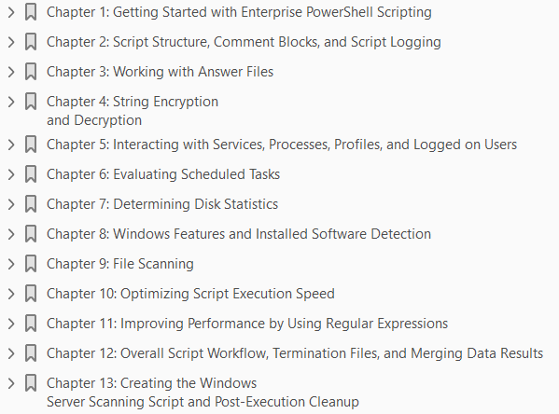

Slide 4
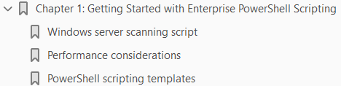
1
Getting Started with Enterprise PowerShell Scripting

Slide 5
Intro
The PowerShell language was developed to provide engineers with a method to quickly automate the provisioning and management of environments.
In the last decade, PowerShell's use has greatly expanded, to encompass the setup and configuration of a myriad of hardware and software systems.
Since third-party manufacturers are creating PowerShell modules to control their systems, PowerShell is becoming the automation language of choice.
It is being used to configure multiple systems from multiple manufacturers, with a single set of PowerShell code.
Creating scripts for enterprise environments requires a robust scripting framework.
A scripting framework consists of reusable code that you can leverage for a large majority of your scripts.
This framework needs to be efficient, reliable, and secure.
It must also provide logging capabilities, leverage answer files, and be flexible for execution on a wide variety of systems.
As you are exploring this book, you will learn a large number of tested and industry-proven scripting techniques.
The examples you create will be applied at the end of the book in a Windows server scanning script.

Slide 6
Intro |
This will enable you to quickly integrate new sections of code into your own scripts, and will provide a trusted platform you can confidently deploy in your environment.
In this chapter, you will:
Learn about the Windows server scanning script created throughout this book
Explore performance optimizations implemented throughout each chapter
Review different components you should include in all of your PowerShell scripts

Slide 7
Windows server scanning script

Slide 8
Performance considerations

Slide 9
PowerShell scripting templates

Slide 10
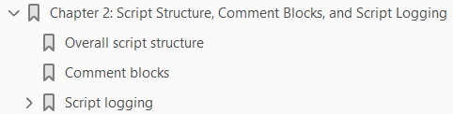
2

Slide 11
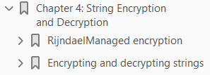
4

Slide 12
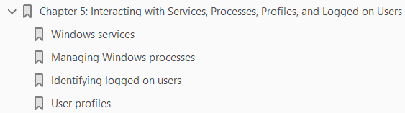
5

